Slide 1
LOG FILE ANALYZER

Slide 2
Overview:-
Introduction
Description
Uses
Demo
Pros and Cons
Conclusion

Slide 3
Introduction
A log file is a document that contains information about every request made to your server. And details about how people and search engines interact with your site.
Log file analysis is the process of downloading and auditing your site’s log file to proactively identify bugs , crawling issues , and other technical SEO problems.
A log file analyzer is a software tool designed to parse, interpret, and extract insights from log files generated by various applications , systems , or services. These log files often contain valuable information about the behavior, performance, errors , and events occurring within the system . By analyzing these logs, developers , system administrators, and data analysts can gain valuable insights into the functioning of system ,troubleshoot issues , monitor performance , and even detect anomalies.

Slide 4
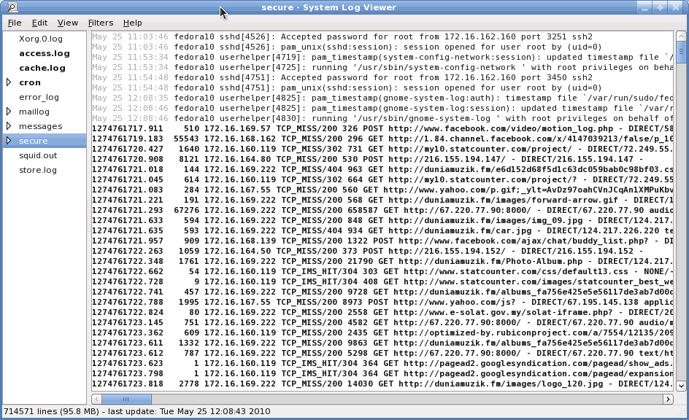
Example of Log File
1
2
3
Creating sample log file
Creating a log file of 100/any no of entries
Analysis of log file

Slide 5
Description Of Log File Analyzer
Log files record various events , activities, errors and status updates that occur during the operation of system or application. Analyzing these log files can provide crucial information about the performance , security and usage of the system or application.
Here’s an overview of what log file analysis involves:
Data collection: Log files are generated automatically by software applications , operating system ,network devices, web servers , databases, and other IT infrastructure components. These log files contain timestamped records of events, actions, errors and other relevant information.
Parsing and preprocessing: the first step in log file analysis is to parse and preprocess these files, extracting relevant data fields and converting them into a standardized format for further analysis.

Slide 6
Data extraction and transformation: Once parsed , log file data is extracted and transformed into a format suitable for analysis . This may involve filtering out irrelevant entries, converting timestamps into a consistent format, and enriching the data with additional context or metadata.
Optimization and troubleshooting : log file analysis plays a crucial role in optimizing system performance, identifying bottlenecks, diagnosing errors and troubleshooting issues. By analyzing historical log data , organizations can identifly recurring problems, root causes, and area for improvement to enhance the recurring problems , root causes, and areas for improvement to enhance the reliability anad efficiency of their IT infrastructure.
Overall, log file analysis is an essential practice for it operations, cybersecurity , compliance , and business intelligence, providing organizations with valuable insights into their system behavior and performance.

Slide 7
Generating 100 Log Entries
Simulating Real-World Activity: To effectively analyze log files, you'll need a substantial amount of data to work with. By generating 100 log entries, you can create a realistic scenario that mirrors the types of events and activities your system experiences in daily operations.
Diverse Data Points :These 100 log entries should cover a range of events, from user actions and system processes to error messages and warning signs. This variety will help you identify patterns, trends, and potential issues more effectively.
Baseline for Analysis :The generated log entries will serve as a baseline, allowing you to compare and contrast future log data to identify changes, anomalies, and areas that require further investigation.

Slide 8
Demo Code:
from datetime import datetime, timedelta
import random
def generate_random_timestamp():
start_date = datetime(2024, 1, 1)
end_date = datetime.now()
random_date = start_date + (end_date - start_date) * random.random()
return random_date
def generate_random_description():
descriptions = [
"Error occurred during processing.",
"Warning: Resource usage exceeded threshold.",
"Success: Operation completed successfully.",
"Attempted login with incorrect credentials.",

Slide 9
To be Continued…
"System update: New version installed.",
"Normal system operation.",
"Data backup completed.“
]
return random.choice(descriptions)
log_entries = []
for _ in range(100):
timestamp = generate_random_timestamp()
description = generate_random_description()
log_entry = f"{timestamp.date()}, {timestamp.time()}, {description}"
log_entries.append(log_entry)
file_name = "system_logs.txt“
with open(file_name, 'a') as file:
file.write("\n".join(log_entries))
print(f"Generated 100 log entries and saved them in '{file_name}’.”)

Slide 10
Analysis Log Files:-
Log file analysis is the process of downloading and auditing your site’s log file to proactively identify bugs, crawling issues, and other technical SEO problems.
Modules used:
Open: bulit-in function to open a file
Print: built-in function to print output to the console
Functions defined:
analyze_log_file: it analyses a log file,searching for lines containing either ERROR or
WARNING.
It returns two lists one containing the lines with errors, and other containing the lines with
warnings.

Slide 11
Function Definition (analyze_log_files):
This function analyze_log_file path as input.
It initializes two empty lists errors and warnings to store lines containing errors and warnings respectively.
The function opens the specified log file in read mode using the open() function.
It then iterates over each line in the file using for a loop.
For each line,it checks if it contains the substring ERROR or WARNING.
If ERROR is found in the line, it appends the line (after stripping whitespace) to the warnings list
After processing all lines in the file, the function returns the lists of errors and warnings.

Slide 12
2.Assigning log file name: log file is assigned to system_logs.txt
3.Function call:
The analyze_log file function is called with the log_file variable as argument.
The returned values (errors_found and warnings_found) are assigned to varibles errors_found and warnings_found respectively.
4.printing Results:
The code prints a header Errors found: indicating that the following lines will display the errors found.
It then iterates aver each error in the errors-found list and prints each error.
After printing errors, it prints a separator.
It then prints ader warnings found: indicating that the following lines will display the warnings found.
It iterates over each warning in the warnings_found list and prints each warning

Slide 13
Pros of Log Files
Performance Monitoring
User Behaviour Analysis
Performance Optimization
Root Cause Analysis
Compliance and Auditing
Security
Monitoring
Issue Detection and Trouble
shooting:

Slide 14
Cons of Log File Analyzer
Complexity and Volume
Real-Time Analysis Challenges
Privacy and Compliance Concerns

Slide 15
Conclusion
Log file analysis is an essential task in many fields, such as system administration, security, and data science. By analyzing log files, you can gain valuable insights into system performance, user behavior, and potential issues.
Using Python for log file analysis is an excellent choice due to its extensive libraries and tools, such as:-
Re (regular expressions) for pattern matching
Pandas for data manipulation and analysis
Matplotlib and Seaborn for data visualization

Slide 16


